Slide 1
LevelDB-Study
Team_Cache Code Analysis
Made by Subin Hong, Seungwon Ha
E-Mail: zed6740@dankook.ac.kr, 12gktmddnjs@naver.com

Slide 2
Contents 1. Overrall flow chart 2. Cache – Code flow 3. After Analysis
Overrall flow chart
Code flow -Read, Insert, Delete

Slide 3
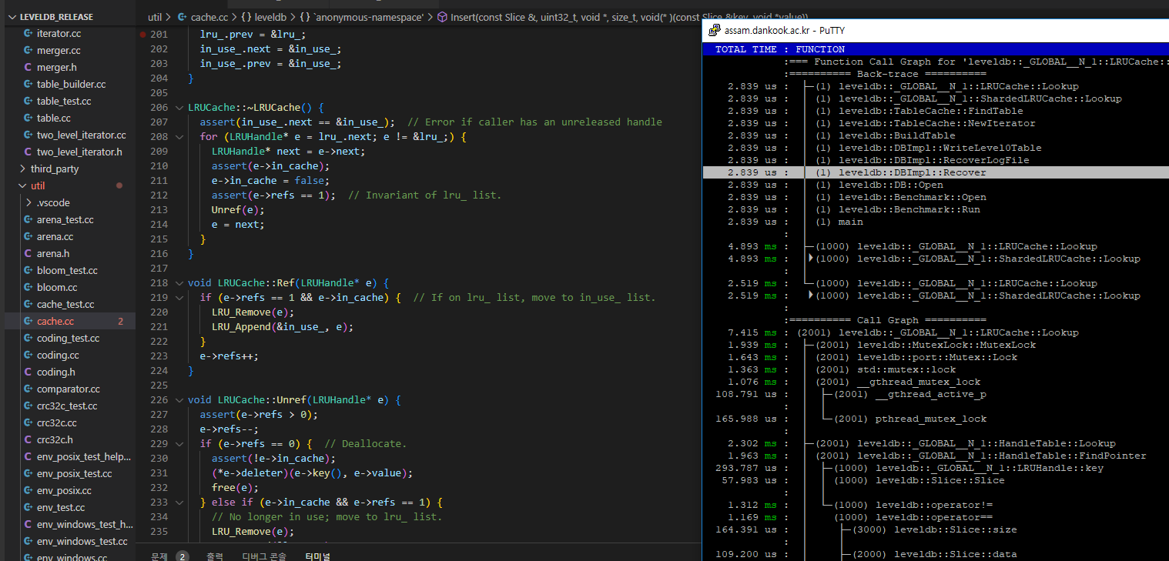
How to Understand
Use uftrace tui to understand flow of the functions
Look up the code to understand the function’s function

Slide 4
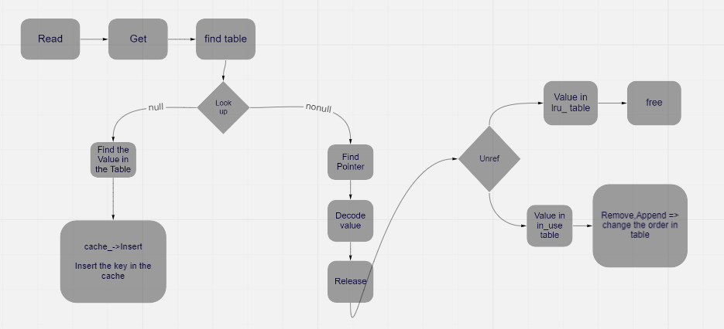
Overrall cache flow chart

Slide 5
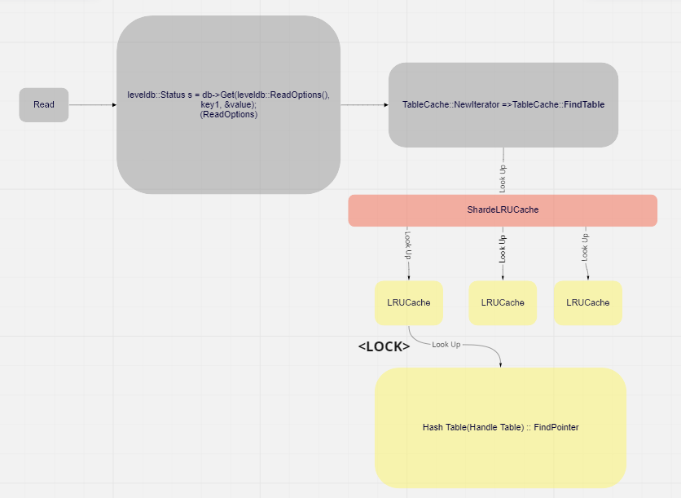
Code flow - (1)Read flow

Slide 6
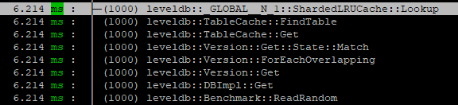
Code flow - (1)Read flow
-uftrace tui

Slide 7
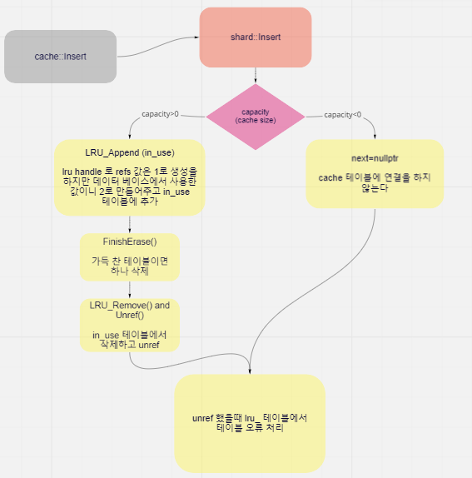
Code flow - (2)Insert flow

Slide 8
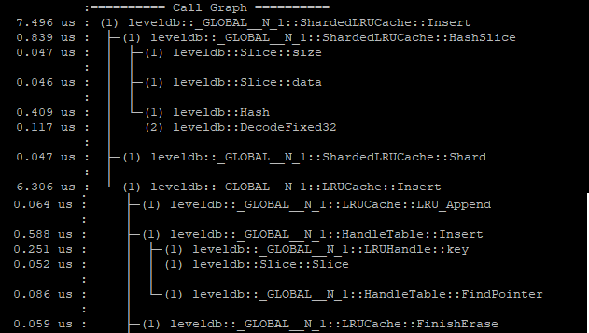
Code flow - (2) Insert flow
-uftrace tui

Slide 9
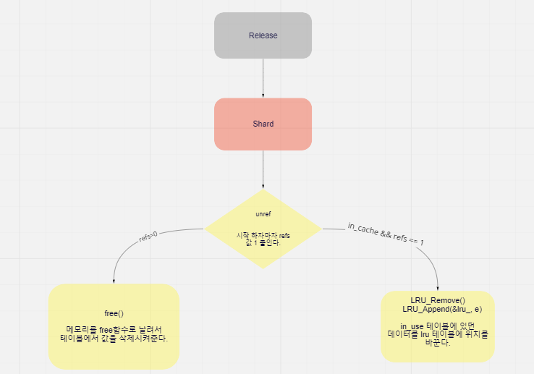
Code flow - (3) Release(call by=unref entry, Get()) flow

Slide 10
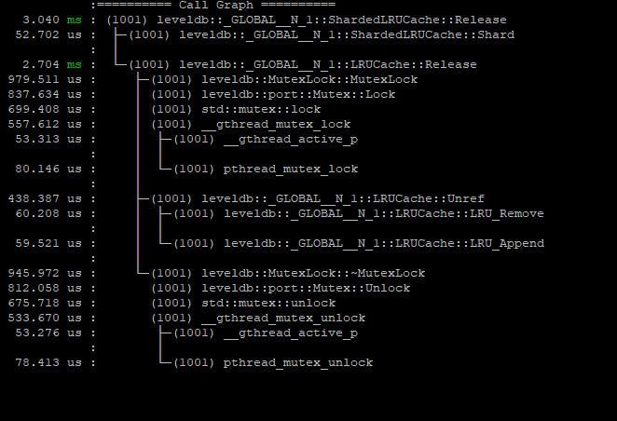
Code flow - (3) Release(call by=unref entry, Get()) flow
-uftrace tui

Slide 11

Q&A

